Slide 1
Business Intelligence Concepts, Tools, and Applications
Week 2: Business Intelligence Concepts and Platform Capabilities
Lesson 1: BI Concepts

Slide 2
BI Concepts
Learning Objectives
Define Business Intelligence
Learn Evolution of Business Intelligence Capabilities
Define BI architecture and its components
Summarize main applications and business value for BI

Slide 3
What is Business Intelligence
Business Intelligence (BI) is an umbrella term that combines architectures, databases, analytical tools, applications, and methodologies.
The Data Warehousing Institute (TDWI 2002) working definition of business intelligence:
“The processes, technologies, and tools needed to turn data into information, information into knowledge, and knowledge into plans that drive profitable business action. Business intelligence encompasses data warehousing, business analytic tools and content/knowledge management”
Notes:
The term BI was coined by the Gartner Group in the mid-1990s. However, the concept is much older; it has its roots in the MIS reporting systems of the 1970s. During that period, reporting systems were static, two dimensional, and had no analytical capabilities.
This definition is broad. BI encompasses not only applications, but also technologies and processes. It includes not only “getting data out” (through tools and applications), but also getting “data in” (to a data mart or warehouse).
Another definition: “Business Intelligence is the science of analyzing business data wherever it exists within your organization or elsewhere in order to understand what has happened in the past, why it happened in the first place and what can be expected to happen in the future and why that might happen differently given different behavior.”
“BI is neither a product nor a system. It is a generic concept that blends infrastructure databases and applications. It lets business users access, analyze and manipulate data, whether it’s financial, sales, marketing, operational/ production, HR-related” (Hart 2005).
Its major objective is to enable interactive access (sometimes in real time) to data, enable manipulation of these data, and to provide business managers and analysts the ability to conduct appropriate analysis.
It is, like DSS, a content-free expression, so it means different things to different people. Differences between BI and DSS
BI uses a data warehouse, whereas DSS can use any data source (including a data warehouse).
Most DSS are built to support decision making directly, whereas most BI systems are built to provide information that it is believed will lead to improved decision making.
BI has a strategy/executive orientation whereas DSS are usually oriented toward analysts.
BI systems tend to be developed with commercially available tools, whereas DSS tend to use more custom programming to deal with problems that may be unstructured.
DSS methodologies and tools originated largely in academia, whereas BI arose largely from the software industry. Many BI tools, such as data mining and predictive analysis, have come to be considered DSS tools as well.

Slide 4
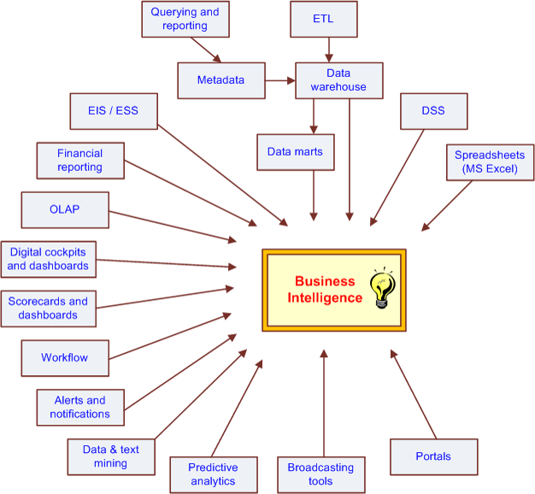
Evolution of BI Capabilities
From SHARDA, RAMESH; DELEN, DURSUN; TURBAN, EFRAIM, BUSINESS INTELLIGENCE AND ANALYTICS: SYSTEMS FOR DECISION SUPPORT, 10th Edition, © 2015. Used by permission of Pearson Education, Inc., New York, NY. All Rights Reserved.
Notes:
From SHARDA, RAMESH; DELEN, DURSUN; TURBAN, EFRAIM, BUSINESS INTELLIGENCE AND ANALYTICS: SYSTEMS FOR DECISION SUPPORT, 10th Edition, © 2015. Used by permission of Pearson Education, Inc., New York, NY. All Rights Reserved.

Slide 5
A High-Level BI Architecture
Source: Eckerson, W. Smart Companies in the 21st Century: The Secrets of Creating Successful Business Intelligent Solutions. The Data Warehousing Institute, Seattle, WA, 2003, p. 32
Notes:
A High-Level Architecture of BI. Source: Based on W. Eckerson, Smart Companies in the 21st Century: The Secrets of Creating Successful Business Intelligent Solutions. The Data Warehousing Institute, Seattle, WA, 2003, p. 32, Illustration 5.

Slide 6
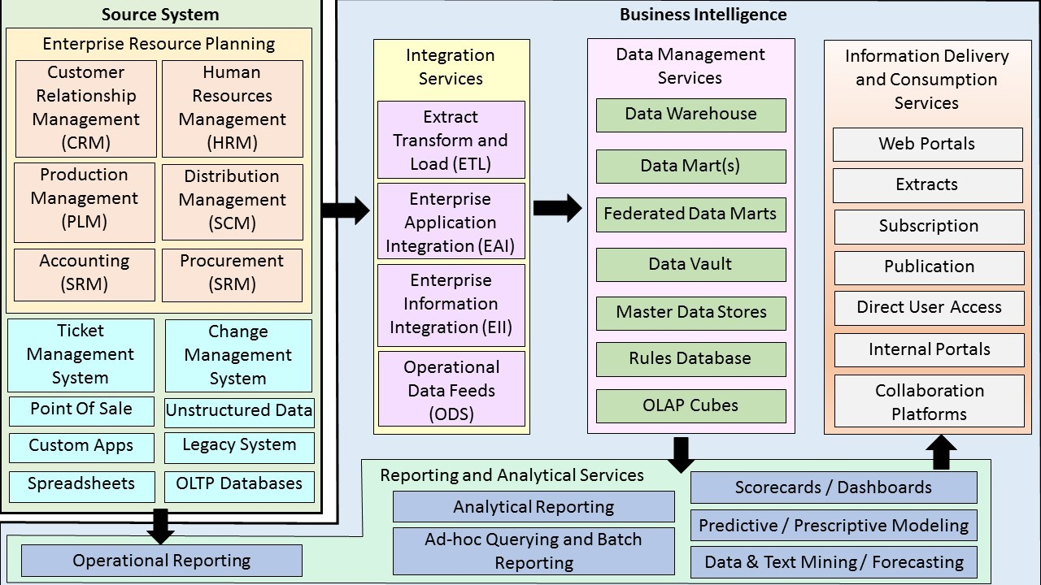
Detailed level BI Architecture
Based on: Pant, P. Business intelligence (BI): How to build successful BI Strategy, Deloitte Consulting LLP. 2009.
Notes:
Source Pant, P. Business intelligence (BI): How to build successful BI Strategy, Deloitte Consulting LLP. 2009.
According to Pant (2009) BI architecture varies in each enterprise but there are some common components of BI architecture, which are found in some shape or form in all BI solutions. What is included in your BI architecture will be driven by the objectives, goals and requirements of your enterprise.
Above diagram depicts a comprehensive representation of the typical BI architecture. Multiple disparate Data sources, data integration services, data management services, reporting, analytical services, information delivery, and consumption services form the broad spectrum of the BI architecture.
Figure shows a generic BI environment. At the left are the source systems that provide data to the decision support data repository (i.e., data warehouse and marts). Data integration technology and processes are needed to prepare the data for decision support use. The mart or warehouse can employ a variety of architectures, technologies, and data models. On the top, a variety of users can access the data using different tools and applications. To ensure that BI meets its intended purposes, metadata, data quality, and governance processes must be in place.

Slide 7
Source Systems
Many possible sources – (ERP, Ticket and Change management system, point of sale, legacy system, unstructured data, etc.)
Many platforms – IBM, Oracle, Microsoft, Sybase, SAS
Many formats – Relational, Hierarchical, Columnar, Multi-dimensional, Big data MapReduce Databases, Unstructured text data
Notes:
Source system: ERP systems: (CRM, HRM, Production Management (PLM), Supply chain Management (SCM), Accounting (SRM), Procurement (SRM), Ticket management system, change management system) , point of sale, unstructured data, legacy system, spreadsheets, OLTP Data bases. Ticket and Change management system, point of sale, legacy system, unstructured data, etc.

Slide 8
BI Services components
Integration Services (ETL, Operational Data Feeds, Enterprise Application Integration, Enterprise Information Integration)
Data Management Services (data warehouse, data marts, federated data marts, OLAP cubes, etc.)
Reporting and Analytical Services (Analytical Reporting, ad-hoc query and batch reporting, dashboards/scorecards, predictive and prescriptive modeling, data & text mining/forecasting)
Information Delivery and Consumption Services (Web portals, subscription, direct user access, internal portals
Notes:
Integration services: Extract, Transform, and Load (ETL), Enterprise Application Integration EII, Operational data feeds (ODS)
Data Management services: Data warehouse, OLAP,
Reporting, Distribution, and transaction services. A collection of tools for manipulating, mining, analyzing the data in the data warehouse, and unstructured text data, business performance management dashboards/scorecards.

Slide 9
Types of BI users
IT developers
Analysts
Information workers
Managers and executives
Front line workers
Suppliers, customers, and regulators
Source Watson, H. J., "Tutorial: Business Intelligence –Past, Present, and Future," Communications of the Association for Information Systems: Vol. 25, Article 39, 2009.
Notes:
Source Watson, H. J., "Tutorial: Business Intelligence –Past, Present, and Future," Communications of the Association for Information Systems: Vol. 25, Article 39, 2009. Available at: http://aisel.aisnet.org/cais/vol25/iss1/39

Slide 10
BI Applications
Business intelligence (BI) used for decision making can be broken into three main types of applications:
Strategic
Tactical
Operational
See White, C. Critical Agility: Operational BI Generates Faster and Smarter Decisions., TeraData Magazine Volume 9, No. 1, March 2009.
Notes:
According to White, Critical Agility: Operational BI Generates Faster and Smarter Decisions. TeraData Magazine Volume 9, No. 1, March 2009,
BI used for decision making can be broken into three main types of applications: BI initiative can help enterprise achieve strategic, tactical, and operational goals. BI vision should be to help drive better business performance by enabling all decision makers essentially empowering all employees, customers, and external parties to be able to play their roles effectively as a result of the BI adoption.

Slide 11
Strategic BI Applications
Such applications help executives as well as business and financial analysts assess progress in achieving long-term, enterprise-wide goals such as increased revenue or market share, reduced costs, better customer retention and improved profitability.
For example, Strategic dashboards can reflect enterprise-wide strategic goals, as well as corresponding KPIs.
Features on this type of dashboard include global, external, trends and growth measures, all of which are related to or based on the Balanced Scorecard Methodology
Source White, C. Critical Agility: Operational BI Generates Faster and Smarter Decisions., TeraData Magazine Volume 9, No. 1, March 2009.
Notes:
Source Critical Agility: Operational BI Generates Faster and Smarter Decisions
According to white (2009) , BI strategy should aim to support the complete breadth of decision making ability in the enterprise. Strategic decisions deal with the long-term planning, performed by top management, focus mostly on demographic, and industry trends. These address broad issues to achieve general objectives. Strategic decisions are where BI traditionally has been implemented. Businesses today want more than just strategic insight from their BI implementations.

Slide 12
Tactical BI Applications
These focus on analyzing short-term initiatives within specific line-of-business domains, such as marketing, sales, purchasing or customer service. Helping sales managers optimize their region-wide campaigns is an example of this type of BI application. For example:
Tactical (also called analytical) dashboards measure the business’s progress according to related trends, in accordance with each strategic initiative. Progress is measured against a preset goal, such as a budget or a certain target.
Drilldowns reveal details and break down data for analysis. For example, they help determine why certain targets were not met and where a potential problem might be.
Source White, C. Critical Agility: Operational BI Generates Faster and Smarter Decisions., TeraData Magazine Volume 9, No. 1, March 2009.
Notes:
Strategic and tactical BI approaches employ query, reporting and analysis applications to process operational data that has been consolidated into a data warehouse.

Slide 13
Operational BI Applications
This type features process-centric solutions for monitoring and optimizing specific business processes, such as call center operations, loan processing and inventory management.
Operational applications are designed to help organizations manage their intra-day and daily business operations. For example:
Operational dashboards monitor specific business processes, such as order processing and shipping.
They are mainly used at the departmental level, where operations take place.
Updates are tracked daily or weekly using real time charts and reports, and detailed data is presented with strong analytical functionality in order to perform a root-cause analysis.
Source White, C. Critical Agility: Operational BI Generates Faster and Smarter Decisions., TeraData Magazine Volume 9, No. 1, March 2009.
Notes:
Source White, C. Critical Agility: Operational BI Generates Faster and Smarter Decisions., TeraData Magazine Volume 9, No. 1, March 2009.
According to White (2009) operational BI can be implemented by improving the speed of traditional BI. Organizations often begin operational BI initiatives by looking for ways to enhance the agility of traditional BI or by using existing data for new applications.

Slide 14
BI Business Value
According to Williams (2004), BI can add value to:
Management Processes:
Planning budgeting, performance monitoring/assessment, process improvement, cost analysis, optimization, etc.
Revenue Generating Processes:
Customer segmentation, campaign management, channel management, sales management, etc.
Resource Consumption Processes:
Product/service development, order management, manufacturing/operations, supply chain, purchasing, etc.
Adopted From Williams (2004) Assessing BI Readiness: A key to BI ROI. Business Intelligence Journal, Vol. 9, pp. 15-23, summer 2004
Notes:
According to Williams , Assessing BI Readiness: A key to BI ROI. Business Intelligence Journal, Vol. 9, pp. 15-23, summer 2004, the business value of business intelligence lies in its ability to improve the effectiveness of the core business processes that drive business performance. In the private sector, business performance ultimately means revenue generation and profit delivery. In the public sector, it means accomplishing a mission with an affordable balance between service level and productivity.
According to Ziama and Kasher “Data Mining Primer for the Data Warehousing Professional. Teradata, Dayton, OH, 2004”, analytic application can add business value in the following areas:
Customer segmentation What market segments do my customers fall into, and what are their characteristics?
Personalize customer relationships for higher satisfaction and retention.
Propensity to buy Which customers are most likely to respond to my promotion? Target customers based on their need to increase their loyalty to your product line. Also, increase campaign profitability by focusing on the most likely to buy.
Customer profitability What is the lifetime profitability of my customer? Make individual business interaction decisions based on the overall profitability Of customers.
Fraud detection How can I tell which transactions are likely to be fraudulent? Quickly determine fraud and take immediate action to minimize cost.
Customer attrition Which customer is at risk of leaving? Prevent loss of high-value customers and let go of lower-value customers.
Channel optimization What is the best channel to reach my customer in each segment? Interact with customers based on their preference
and your need to manage cost.

